Slide 1
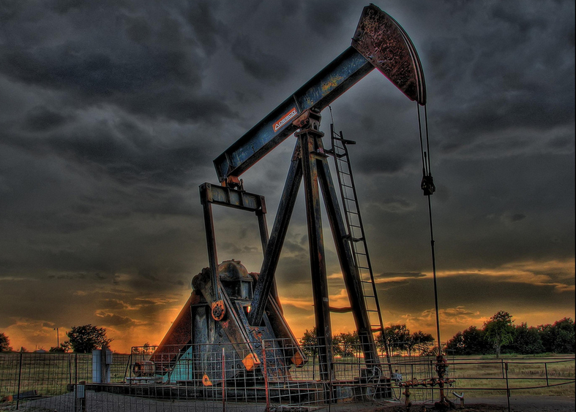
VOLATILITY IN THE OILPATCH: WHERE DID ALL THE VALUE GO?
Panel Discussion
Christopher J. Marcus, Michael O’Hara, Robert J. Stark – Panelists
John Melko – Moderator
Beard Distressed Investing Conference, December 1, 2020

Slide 2
TABLE OF CONTENTS
I. Introduction of Our Panelists
II. Quick Overview of the Oil & Gas Industry
III. Jefferies Upstream Oil and Gas Trends – Michael O’Hara
IV. Hypothetical

Slide 3
I.
Introduction of Our Panelists

Slide 4
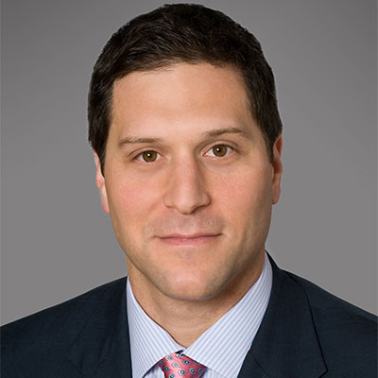
Christopher J. Marcus
Kirkland & Ellis – Partner/Restructuring
Christopher Marcus is a partner in Kirkland's Restructuring Group. He represents debtors, creditors, equity sponsors, and investors in distressed companies in a wide array of industries, including retail, telecommunications, media, real estate, and manufacturing. Most recently, Christopher was recognized in the 2021 edition of IFLR1000. In 2018, he was selected as a Law 360 MVP. He has been recognized in the 2018, 2019 and 2020 editions of Chambers USA, with sources praising him as “a good advocate” and a “talented” lawyer. Christopher was also selected as one of the nation’s “Outstanding Restructuring Lawyers” in 2017 and “Outstanding Young Restructuring Lawyers” in 2007 by Turnarounds & Workouts.

Slide 5









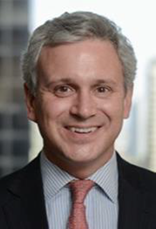
















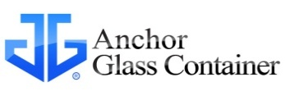







Industrials
August 2015
Media
September 2014
Telecom
Pending
Industrials
June 2016
Sale of its Geoconstruction business to
Keller Group plc
Sole Financial Advisor
Sale to Shamrock Capital
Post-Reorg M&A
Financial Advisor to the Company
Industrials
February 2015
Consumer
June 2015
Consumer
March 2015
Energy
September 2015
$2,750,000,000
Undisclosed
First & Second Lien Exit Financings
Lead Arranger
Recapitalization
Financial Advisor and Sole Arranger
$100,000,000
$287,000,000
(Formerly Allens, Inc.)
$1,566,000,000
Convertible Notes Exchange & Offering
Sole Placement Agent &
Financial Advisor to the Company
Restructuring
Financial Advisor to the Company
Sale to
Del Monte Foods, Inc.
Financial Advisor to the Company
Recapitalization
Financial Advisor to the Company
Michael O’Hara
Jefferies – Co-Head of US & Managing Director
TMT
Pending
Industrials
Pending
Healthcare
April 2019
TMT
February 2019
Michael O’Hara
Co-Head of US & Managing Director
Debt Advisory & Restructuring
Office: (212) 323-3332
Cell: (917) 518-3022
michael.ohara@jefferies.com
Selected Transactions Experience
$307,150,000
  AbitibiBowater
  Akorn Pharmaceuticals
  American Axle & Manufacturing
  American International Group (AIG)
  American Tire Distributions
  Ascent Resources Marcellus
  Atlas Resource Partners
  Brock Group
  Chaparral Energy
  Connacher Oil and Gas
  Dana Corporation
  Delphi
  Eastman Kodak
  Energy Future Holdings
  EP Energy
  Enron (re: Azurix / Argentina)
  EXCO Resources
  Extraction Oil & Gas
  Fusion Connect
  Greece (Hellenic Republic)
  Grupo Bimbo (re: Interstate Bakeries)
  Iceland (re: Kaupthing)
  Intrawest
$650,000,000
$248,000,000
Undisclosed
  Jupiter Resources
  Lehman (re: Lehman Brothers, Inc.)
  Mallinckrodt
  MoneyGram International
  Motorola Mobility (PBGC)
  Mrs. Fields
  New Gulf Resources
  Nexen (re: Opti Canada)
  Penn Virginia
  Preferred Sands
  Premiere Global Services
  Quad Graphics (re: Vertis)
  Quicksilver Resources
  RockPile Energy Services
  Samson Resources
  Southland Royalty Company
  Taro Pharmeceutical
  Travelport
  Triangle Petroleum USA
  Ultra Petroleum
  Vanguard Natural Resources
  Washington Mutual
Credit Facility Amendment
Convertible Notes Exchange
Equity Raise
Financial Advisor to the Company
Restructuring
Financial Advisor to the Company
Restructuring
Financial Advisor to the Company
Distressed M&A
Financial Advisor to the Company
$3,300,000,000
TMT
September 2018
Consumer Finance
July 2018
Maritime
July 2018
Industrials
November 2017
TMT
January 2011
  Michael O’Hara is Co-Head of US and Managing Director in the Debt Advisory and Restructuring Group at Jefferies
  He joined Jefferies in 2020 from PJT Partners (formerly Blackstone), where he was a Partner in the Restructuring and Special Situations Group.
  Mr. O’Hara advises on a variety of restructuring and special situation assignments for companies, creditors, corporate boards, and acquirers and sellers of distressed assets. Additionally, he has worked on several sovereign situations.
  Mr. O’Hara has served as a guest lecturer at the University of Chicago Booth School, Columbia Business School and the Wharton School at the University of Pennsylvania, among others, and has participated in several restructuring industry conferences.
  Before joining Blackstone/PJT, Mr. O’Hara worked in the M&A groups at Wasserstein Perella & Co. and Stephens Inc.
  Mr. O’Hara holds a BS in Finance from Georgetown University and an MBA from Columbia Business School.
TMT
September 2009
Undisclosed
$162,000,000
$300,000,000
$1,588,000,000
Sale to MidOcean Partners
Post-Reorg M&A
Financial Advisor to the Company
Acquisition of
Takata Corporation
Lead Financial Advisor
Restructuring
Financial Advisor to the Official
Committee of Unsecured Creditors
Senior Secured Credit Facility
Financial Advisor to the Company
Exchange Offer
Financial Advisor to the Company
July 2017
Metals & Mining
April 2017
June 2017
Maritime
January 2017
Consumer
November 2016
$270,000,000
Consumer
Specialty Finance
Industrials
April 2013
Restructuring
Financial Advisor to the Company
$460,000,000
$233,000,000
$358,000,000
$402,000,000
Restructuring
Financial Advisor to the Official Committee of Unsecured Creditors
Replacement of Existing Facility and Raise of New Facility
Restructuring
Financial Advisor to Hanjin in Connection with the Sale of its Interests in TTI, LLC
Restructuring
Financial Advisor to the Company
Restructuring
Financial Advisor to the Company
Healthcare
March 2011
Sale to Handy & Harman Ltd
Post-Reorganization
Financial Advisor to the Company
$486,000,000
Energy
October 2016
Energy
September 2016
Energy
September 2016
TMT
May 2016
Industrials
April 2012
$154,000,000
$1,400,000,000
$280,000,000
$794,000,000
Sale to
ARAMARK Corporation
Financial Advisor to the Company
TMT
May 2012
Restructuring
Financial Advisor to the Company
Restructuring
Financial Advisor to the Company
Restructuring
Financial Advisor to the Company
Restructuring
Financial Advisor to the Company
Post-Reorganization Sale to Precision Castpart Corp.
Financial Advisor to the Company
TMT
December 2015
Energy
November 2015
Consumer
October 2015
$90,000,000
A$192,400,000
Sale to M2 Telecommunications
Post-Reorganization
Financial Advisor to the Company
$2,750,000,000
$450,000,000
$211,000,000
First & Second Lien Exit Financings
Lead Arranger
Credit Facility
Sole Lead Arranger
Recapitalization
Financial Advisor to the Company
Industrials
August 2012
Industrials
April 2013
Energy
October 2015
$880,000,000
$470,000,000
Consumer
July 2014
Sale to Ardagh Packaging Group
Post-Reorganization
Financial Advisor to the Company
Sale to H.I.G. Capital
Post-Reorganization
Financial Advisor to the Company
$74,000,000
Maritime
July 2014
Recapitalization
Financial Advisor to the Company
Industrials
April 2010
TMT
September 2009
Industrials
January 2004
$300,000,000
Magnatrax Corporation
Restructuring
Financial Advisor to the Special committee of the Board of directors
Consumer
May 2012
Consumer
April 2012
Maritime
February 2014
$140,000,000
$101,000,000
$26,700,000
$1,475,000,000
Restructuring
Financial Advisor to Committee of Convertible Noteholders
Senior Secured Notes Offering Sole Bookrunning Manager
Sale to Otelco
Sole Financial Advisor
Sale to Desco Capital Partners
Financial Advisor to the Company
$500,000,000
$900,000,000
$994,000,000
Restructuring
Financial Advisor to Official
Committee of Unsecured Creditors
Senior Secured Credit Facilities
Joint Lead Arranger
Restructuring Advisor to Company
Restructuring
Financial Advisor to the Company

Slide 6
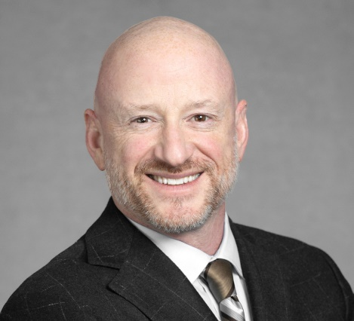
  Robert J. Stark
  Brown Rudnick LLP - Partner
  Robert Stark focuses his practice on complex corporate restructuring, including in-court Chapter 11 cases and out-of-court workouts. He has extensive experience representing debtors/borrowers, secured and unsecured creditors, official creditor/equity committees, and other significant parties-in-interest in large corporate insolvency matters.
  Robert led the firm’s representation in the following significant case matters (among many others):
  Debtors/Borrowers: Allied Systems Holdings (special committee of the Board); Centrix Financial (primary stockholder, Chairman and CEO); GIC Portfolio (out-of-court workout); Keys Resort (Chapter 11 debtor); Sable Permian Resources (equity sponsor); SunEdison (special litigation counsel); Wells Dairy/Blue Bunny Ice Cream (out-of-court workout).
  Secured Term Lenders/Bondholders: Atlantis Resort and Casino; American Safety Razor; EPV Solar; Evergreen International Aviation; Flying J/Big West Oil; Geokinetics; Hawkeye Renewables; JCPenney; J.Crew; Le-Nature’s; Millennium Labs; Minnesota Star Tribune; Newark Group; New Vision Broadcasting; Pier 1 Imports; ServiceMaster; Spansion; Sports Authority; Synagro Technologies; TOUSA; Vanguard Natural Resources.
  Unsecured Bondholders/Creditors: Advanced Lighting; C-BASS; CEDC; Collins & Aikman; Colt Defense; Delphi Corporation; Delta Petroleum; Endeavour International; Energy Conversion Devices; Falcon Products; Forest Oil/Sabine Oil & Gas; InSight Health Services; Intelsat; LightSquared; McDermott Internationall; Orexigen; Patriot Coal; SIRVA/North American Van Lines; TerraVia; TetraLogic Pharmaceuticals; Tribune Company.
  Official Creditor/Equity Committees: Alta Mesa Resources; Aralez Pharmaceuticals; Briggs & Stratton; Chesapeake Energy; Dolan Company; EdgeMarc Energy; EXCO Resources; Fedders; Green Field Energy Services; Green Valley Ranch Hotel and Casino; Legacy Reserves; Libbey Glass; Lionel Trains (special counsel); Motor Coach Industries; Oakwood Homes Corporation; Oneida; Performance Sports Group; Philadelphia Energy Solutions; Ravn Air Group; Rex Energy; Riverstone Networks; School Specialty; Ultra Petroleum; Visteon Corporation.
  Preferred Stockholders: Spanish Broadcasting; Washington Mutual.
  Post-Confirmation Litigation/Liquidation Trusts: Bethlehem Steel; Bricolage Capital; Geneva Steel; Green Field Energy Services; Hayes Lemmerz International; Le-Nature’s; Millennium Labs; Oakwood Homes Corporation; Performance Sports Group; and WCI Communities.

Slide 7

John Melko
FOLEY & LARNDER LLP – Partner
John Melko's practice focuses on complex sales, acquisitions, bankruptcies and financings in the energy sector throughout the United States, as well as shipping-related issues in both foreign and domestic cases and financings. John has years of cross-border and multinational experience with oil and gas exploration and production, refining and marketing, airlines, telecommunications, electric utilities, manufacturing, retail, rig and ship finance, mass torts and asset-backed securities. He has represented:
  Borrowers and debtors in possession
  Creditors and creditors' committees
  Securitized noteholders
  Trustees
  Investors
  Buyers of assets and businesses in and out of restructuring or bankruptcy settings
​Throughout his career, John has helped guide clients through dislocations in the energy, shipping, telecommunication, real estate and health care markets, utilizing chapter 7, chapter 11, and chapter 15 procedures.
John also serves as co-chair of the firm's Bankruptcy & Business Reorganizations Practice and vice-chair of the firm’s Oil & Gas Industry Team.

Slide 8
II.
Quick Overview of the Oil & Gas Industry

Slide 9
WHAT AFFECTS VALUE?
Commodity price
Performance – are the wells performing as forecast
Volume:
Loss of production
Failure to maintain properties
Loss of leases entirely due to failure to drill within primary term and extensions
Loss of leases/retention of acreage regarding failure to meet drilling commitment
Other :
Gathering & processing contracts
FERC regulated transportation contracts

Slide 10
HOW CAN INVESTORS PROFIT FROM THIS?
Consolidation
Rationalization of overhead
Development
The ubiquitous “blowdown” case

Slide 11
CURRENT RIG COUNT
Updated November 25, 2020
Baker Hughes – Rig Count Overview & Summary Count
Area | Last Count | Count | Change from Prior Count | Date of Prior Count | Change from Last Year | Date of Last Year's Count
U.S. | 25 Nov 2020 | 320 | +10 | 20 Nov 2020 | -482 | 29 Nov 2019
Canada | 25 Nov 2020 | 102 | +1 | 20 Nov 2020 | -24 | 29 Nov 2019
International | Oct 2020 | 656 | -46 | Sept 2020 | -474 | Oct 2019

Slide 12
LAST YEAR’S U.S. PRODUCTION AND RIG COUNT
2019
Production | Price
11 . 8 m bpd* | $53.18**
3.3 tcf/month* | $2.24/mcf**
 | 802***
* As of July 2019/EIA
** As of 10/21/2019
*** As of 11/29/19 Baker Hughes

Slide 13
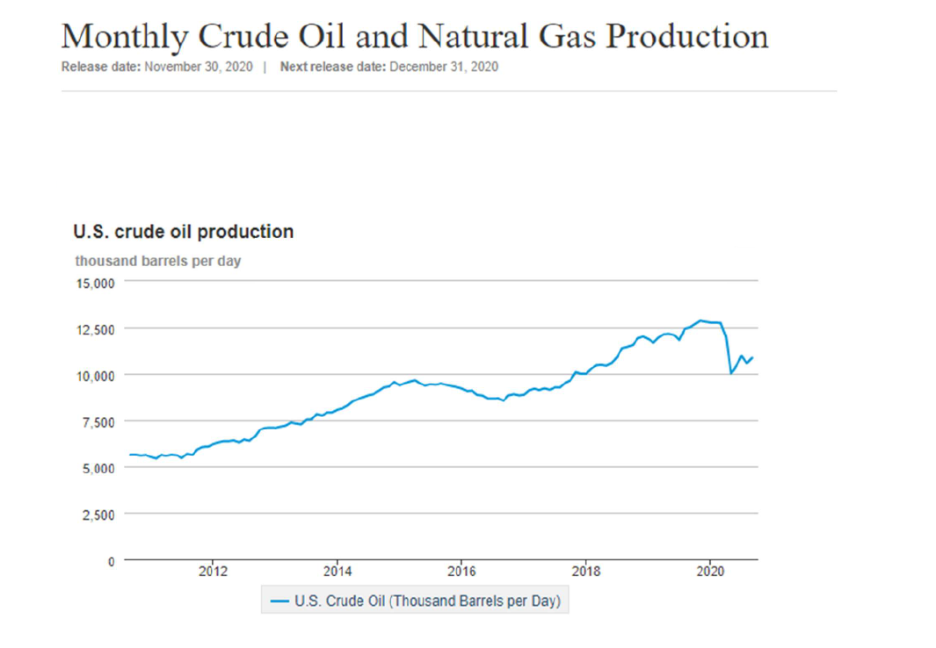

Slide 14
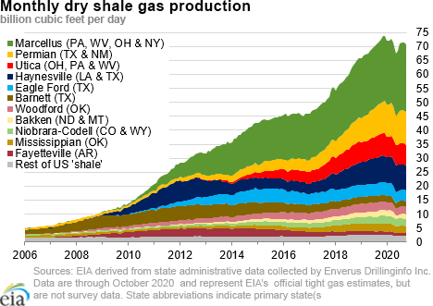

Slide 15
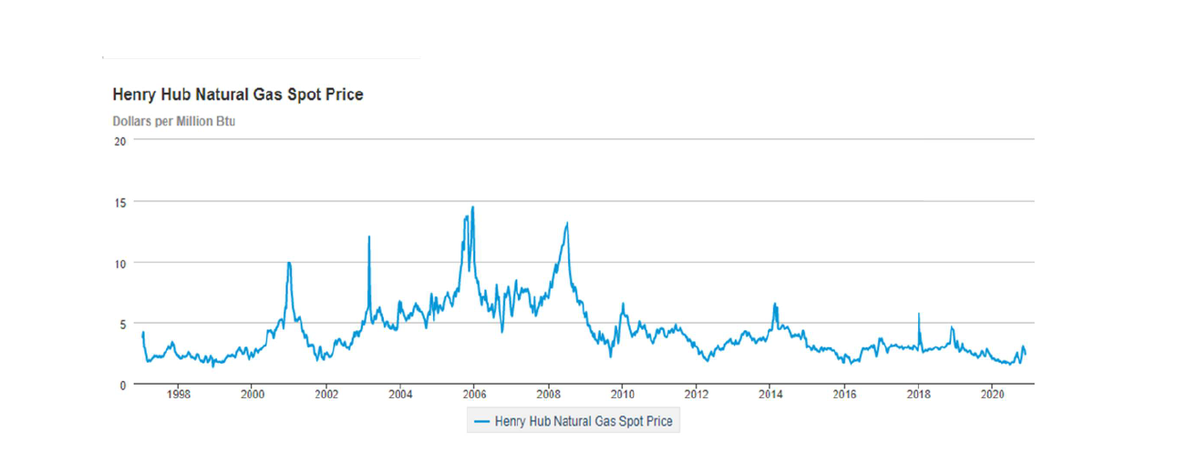

Slide 16
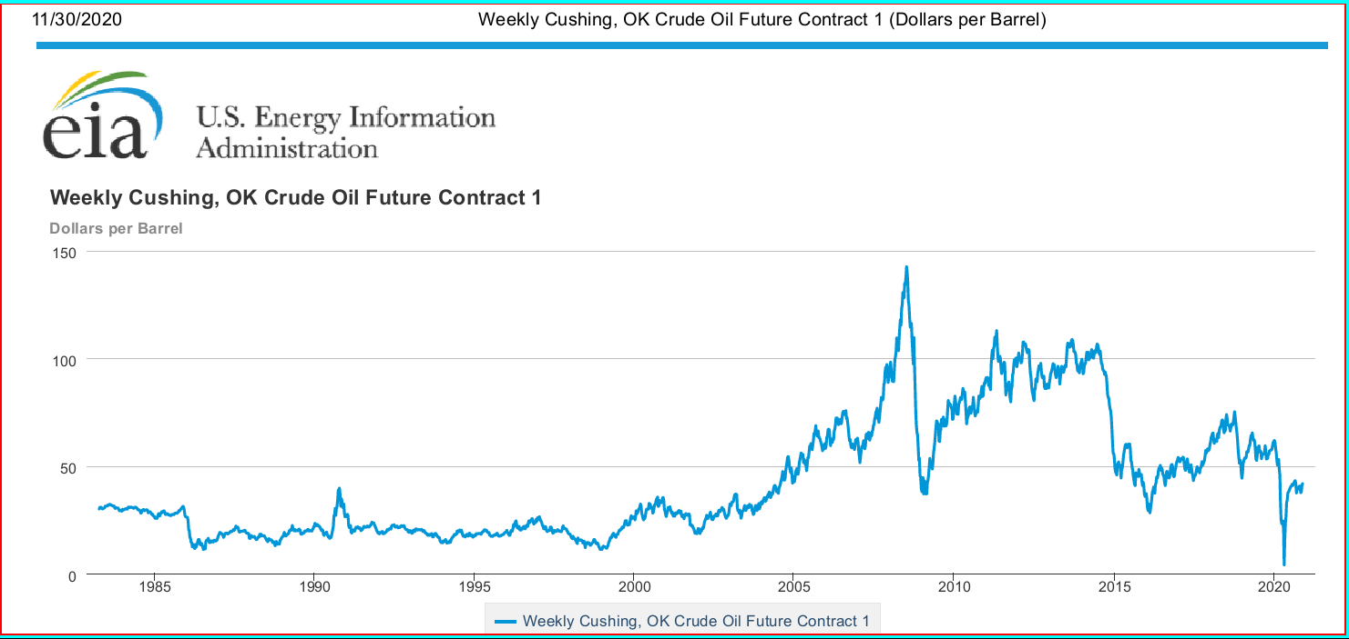

Slide 17
Wells Fargo Commodities
Daily Energy Report as of 11/27/2020
WTI Swap (S/bbl)
Tenor | Current | Day Change | YTD Change
Bal20 | $45.24 | ($0.50) [ -1.10% ] | ($10.72) [ -19.16% ]
Cal21 | $45.60 | ($0.29) [ -0.62% ] | ($8.43) [ -15.61% ]
Cal22 | $45.13 | ($0.11) [ -0.24% ] | ($6.82) [ -13.14% ]
Cal23 | $45.15 | $0.01 [ 0.03% ] | ($6.12) [ -11.94% ]
Cal24 | $45.33 | $0.09 [ 0.21% ] | ($6.17) [ -11.97% ]

Slide 18
Wells Fargo Commodities
Daily Energy Report as of 11/27/2020
NatGas
Tenor | Current | Day Change | YTD Change
Cal21 | $2.818 | ($0.037) [ -1.31% ] | $0.40 [ 16.35% ]
Cal22 | $2.675 | ($0.027) [ -0.99% ] | $0.26 [ 10.78% ]
Cal23 | $2.505 | ($0.023) [ -0.89% ] | $0.05 [ 2.09% ]
Cal24 | $2.483 | ($0.023) [ -0.90% ] | ($0.01) [ -0.59% ]

Slide 19
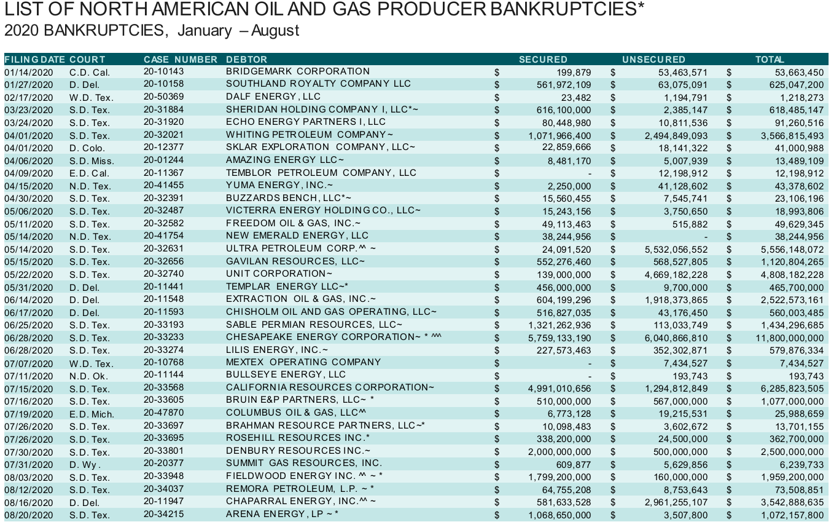
O & G COMPANIES
RECENT HISTORY –
2020 Chapter 11 filings of Exploration & Production (“E&P”) Companies
* from Haynes & Boone’s Oil Patch Bankruptcy Monitor

Slide 20
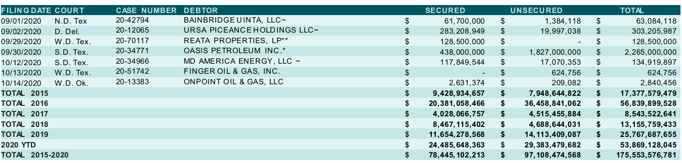
LIST OF NORTH AMERICAN OIL AND GAS PRODUCERS BANRUPTCIES*
2020 BANKRUPTCIES, September - October 2020
* from Haynes and Boone Oilfield Services Bankruptcy Tracker

Slide 21
III.
Jefferies Upstream Oil and Gas Trends
Michael O’Hara

Slide 22
Jefferies Upstream Oil and Gas Trends
December 2020 / Confidential
Jefferies LLC
Member SIPC
The information provided in this document, including valuation discussions, represents the views of Jefferies Investment Banking. There is no assurance that the views expressed herein will be consistent with the views expressed by Jefferies Research or its Analysts. Nothing in this document should be understood as a promise or offer of favorable research coverage.

Slide 23







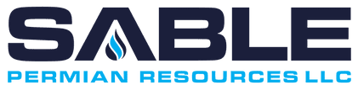












Summary of Distressed E&P Situations
Key Points
  As opposed to the prior cycle, the banks are the fulcrum in a number of situations
  Numerous bankruptcy / distressed situations are resulting in 363 sales or “cram-downs”
    Creditors have limited access to capital in the current cycle and numerous “problem children” across the portfolio; not all businesses can be supported by existing creditors as they have been before
  There are already a number of material impairments to RBL facilities with a number of other facilities at risk
Reorganizations in Progress
Emerged / Auctioned
i

Slide 24
Lenders Have Been Reducing Energy Exposure
($ Billions)
Key Points
  Banks have made a concerted effort to limit their energy (and specifically their E&P) exposure since the last downturn
    Energy funded loans as a % of total loans decreased ~26% and ~29% for large cap and mid cap / regional banks, respectively
    E&P funded loans as a % of total loans decreased ~37% and ~13% for large cap and mid cap / regional banks, respectively
Funded Energy Exposure 2014 – 2020 % of Total Loans
29%
26%
 | Energy Exposure |  | % of Total Loans |  | E&P Exposure |  | % of Total Loans
 | 2014 | 2020 | 2014 | 2020 | 2014 | 2020 | 2014 | 2020
Large Cap Banks
Bank of America | $23.8 | $18.3 | 4.7% | 2.5% | $- | $- | - | -
Citigroup | $21.6 | $22.3 | 3.4% | 3.3% | $6.5 | $6.0 | 1.0% | 0.9%
Wells Fargo | $18.4 | $14.3 | 2.1% | 1.4% | $10.1 | $6.7 | 1.2% | 0.7%
JP Morgan | $15.6 | $15.7 | 2.1% | 1.5% | $- | $- | - | 0.9%
PNC Financial | $2.9 | $4.6 | 1.4% | 1.7% | $0.8 | $1.2 | 0.4% | 0.8%
Goldman Sachs | $2.1 | $4.0 | 4.5% | 3.0% | $- | $- | - | -
Total / Average | $84.5 | $79.2 | 2.8% | 2.1% | $17.4 | $13.9 | 0.6% | 0.4%
Mid Cap / Regional Banks
Comerica | $3.6 | $2.1 | 7.3% | 4.0% | $2.5 | $1.7 | 5.2% | 3.2%
Regions Financial | $3.4 | $2.4 | 4.3% | 2.7% | $1.1 | $1.1 | 1.5% | 1.2%
Zions Bancorp | $3.1 | $2.6 | 7.7% | 5.2% | $1.1 | $1.0 | 2.6% | 2.1%
BOK Financial | $2.9 | $4.1 | 20.1% | 18.3% | $2.5 | $3.2 | 17.3% | 14.2%
Fifth Third Bank | $2.0 | $3.4 | 2.2% | 2.9% | $1.0 | $2.8 | 1.1% | 2.4%
Cullen Frost Bankers | $1.8 | $1.6 | 16.1% | 10.2% | $1.2 | $1.3 | 10.6% | 8.3%
Hancock Whitney | $1.7 | $0.9 | 12.4% | 4.4% | $0.6 | $0.4 | 4.7% | 2.1%
CIT Group | $1.4 | $1.0 | 5.7% | 2.2% | $0.2 | $0.6 | 0.8% | 1.2%
Texas Capital | $1.2 | $1.3 | 8.3% | 5.4% | $- | $- | - | -
Cadence Bank | $1.1 | $1.5 | 17.5% | 11.1% | $0.6 | $0.3 | 9.1% | 2.5%
Prosperity Bancshares | $0.5 | $0.7 | 5.6% | 3.8% | $0.2 | $0.4 | 2.4% | 2.3%
Total / Average | $22.6 | $21.6 | 6.4% | 4.6% | $11.0 | $12.8 | 3.1% | 2.7%
Funded E&P Exposure 2014 – 2020 % of Total Loans
13%
37%
Source: Company filings, presentations and earnings calls.
ii

Slide 25
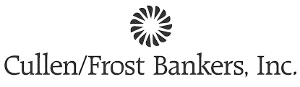



RBL Lender Sentiment Indicates Further Reduction of Exposure Going Forward
Key Points
  Recently, certain RBL lenders have indicated to investors that they intend to reduce exposure to energy loans over time
    Moody’s and JP Morgan forecast a total reduction of as much as 30% to banks’ exposure to reserve based loans ⁽¹⁾
  While many regional banks were established on lending to the sector, they see merit in diversifying as their stock performance has consistently lagged their peers
"… We have been working to reduce the exposure of the energy portfolio, and we'll continue to do so. We're going to get it below the 10% level. I'd like to see it move more towards the mid-single digits over time.”
“We put a massive effort in the fourth quarter into reducing particularly distressed energy loans. So that production portfolio dropped by $145 million … So it's -- there's been a massive de-risking of the energy book. We're not done yet. We probably have another $50-or-so-million at least to go in the energy portfolio based upon what we know today. That number could grow if energy prices back up …"
Philip D. Green
Chairman & CEO
Q1 Earnings Call – 4/30/2020
Kevin J. Hanigan
President COO & Director
Q4 Earnings Call – 1/29/2020
"However, we also saw a decrease in legacy energy loans of $164 million over the course of 2019. We expect to continue shrinking our energy book in 2020 … We hit our energy concentration goal of below 5% during 2019. And with the de-emphasis on that type of lending, we are updating our strategic goal to 2% to 4%."
"… We're imagining, because of the levels of the resource price, that losses given default are substantially worse this time through. In terms of the migration of performing to nonperforming, I'd say in our own credit loss analysis, we're assuming basically across the board, full notch downgrade ... I think we're approaching it in a pretty sober basis”
Michael M. Achary
Senior EVP & CFO
Q4 Earnings Call – 1/16/2020
Charles W. Scharf
President, CEO & Director
Q1 Earnings Call – 4/14/2020
Energy-Focused Regional Bank Lenders Have Historically Underperformed Their Peers
1.3x
1.0x
1.4x
Source: CapitalIQ
Note: Energy Lenders includes BOKF, CADE, CFR, CMA, IBKC, PB, RF, TCBI and ZION. Mid Cap Banks includes banks with $5 - $50 billion in assets.
Per WSJ article “Banks Cut Shale Drillers’ Lifeline as Losses Mount”, published on 6/15/20.
iii

Slide 26













Key Recent Upstream Contract Rejections / Renegotiations
  Distressed upstream businesses increasingly looking to midstream providers for concessions in various forms including: (i) rate reductions, (ii) volume commitment changes and (iii) drill incentives, among others
  Midstream businesses have started to actively negotiate with upstream companies and potential buyers in a number of situations as an alternative to litigation
  The significant in court issue remains the argument regarding contracts that have covenants running with the land such as Chesapeake, Extraction, and Southland and the different jurisdictions that the law is being interpreted
  Additionally, interstate pipelines regulated by FERC have been rejected in several cases and are currently on appeal
E&P Operator
Midstream Service Provider
Date Filed | 1/27/2020 | 5/14/2020 | 6/14/2020 | 6/28/2020 | 11/13/20
Court | Delaware | Texas | Delaware | Texas | Texas
Judge | Karen Owens | Marvin Isgur | Chris Sontchi | David Jones | David Jones
Description | 2 G&P agreements with minimum volume commitment (“L60” and “L63” agreements) | Firm transportation contract on the Rockies Express pipeline that shipped gas east G&P contract with Pinedale LGS that gathered infield volumes; assets previously owned by UPL | Extraction attempting to reject numerous contracts in bankruptcy Focus thus far has been on oil gathering and transportation agreements (Grand Mesa/NGL, Elevation, and ARB Midstream) | ETC inter-state firm transportation contract for Haynesville assets Williams (Access) gathers and processes volumes across the Chesapeake legacy asset base | Immediately moved to reject 6 of 17 long-haul gas transportation contracts across 4 different midstream operators as well as 3 G&P agreements
Commentary | Week long trial in Delaware court in September Of the two gathering agreements, Southland is trying to reject the contract with less-favorable terms Bank syndicate arguing to reject the contract as it has transferred value to Williams that would otherwise be subject to liens from their loan On November 13, Judge Owens ruled that the “L63” gas gathering agreement does not run with the land and may be rejected | Two key elements of the rejection include: (i) satisfaction of the business judgement standard (estate better off) and (ii) no interruption of gas supply to customers as a result of the rejection Rockies Express contract was rejected Pinedale LGS contract (structured as a leaseback financing) was due to be rejected, however, the system was acquired by UPL in bankruptcy for $18 MM (original lease required annual payments of $20 MM through 2027) FERC has filed two appeals: (i) related to the ruling and (ii) related to the bankruptcy courts ability to reject FERC-regulated contracts | On October 14, Judge Sontchi ruled that Grand Mesa (NGL), Platte River/DJ South (ARB Midstream), and Elevation contracts do not create covenants “running with the land” On November 2, Judge Sontchi granted Extraction’s motion to reject its transportation services agreements, applying the deferential business judgment standard instead of a heightened public interest standard that was requested by midstream counterparties Extraction rejected its Grand Mesa and Platte River contracts; however, the company reached an agreement with Elevation prior to ruling that included a settlement with a damage claim | On October 28, Judge Jones approved CHK’s motion to reject its gas purchase agreement with ETC, ruling that the contract does not establish a covenant “running with the land” Decision currently on appeal On November 23, Williams announced an out-of-court settlement with Chesapeake that included Williams taking ownership of certain CHK upstream assets in the Haynesville in return for rate reductions | Plan approval conditioned on 50% reduction of firm transportation reservation fees Rejected long-haul contracts include Rockies Express (Tallgrass/P66), ANR Pipeline (TCP), two Texas Gas contracts (TCP), and Rover (ET) Filed an adversary proceeding against Midship (Cheniere) seeking punitive damages for an improper draw of letters of credit Rejected G&P agreements includes Rice Olympus Midstream (Equitarns), Strike Force (Equitrans), and DCP NGL Services (DCP)
iv

Slide 27
Energy Focused Private Capital in North America
Challenging Private Equity Capital Raising & Capital Deployment Dynamics
Key Points
  Key themes influencing the private capital market:
    Energy private equity returns relative to other sectors have been poor
    Energy private equity fund raising has declined dramatically
  Both dynamics have limited the ability of private equity to compete competitively at auction: (i) no acquisitions of assets >$400 MM in 2020 and (ii) few new teams backed / formed
  Private equity firms have moved to reduce the number of management teams in their portfolio
2017 – 2020 Private Equity Capital Raising ($MM)
 | 2017 | 2018 | 2019 | 2020
Funds (#) | 15 | 13 | 6 | 1
Avg. Size ($MM) | $1,200 | $894 | $1,132 | $233
v

Slide 28




E&P Capital Markets Trends
Public Equity and Debt Markets Have Seen an Increase in Activity Since Q2 2020 Oil Collapse
Equity Capital Markets
  Upstream equities have significantly underperformed the broader public equity market over the last ten years
  Many generalist money managers have left the space
  XOP recently reached its lowest point since the 2008 financial crisis during the peak of the pandemic
  The market for upstream public equity issuances remains challenged
Relative Index Performance ⁽¹⁾
U.S. E&P Equity Issuance by Deal Type ($B) ⁽²⁾
+216%
Alussa Energy Acquisition IPO
(72%)
Debt Capital Markets
  Yields have tightened since peaking in March, but new issue activity has been relatively muted
  Yields on OXY new issues in June have tightened 150-200 bps, encouraging a more recent issuance in August at tighter spreads
  Significant maturity wall in 2021-2024 should drive near-term activity, although market appetite seems limited to higher quality and more established names to date
Yield by Rating ⁽¹⁾
U.S. E&P Debt Issuance by Credit Quality ($B) ⁽²⁾
11.2%
4.7%
2.0%
Source: Capital IQ as of November 13, 2020.
Source: PLS Capitalize as of November 13, 2020.
vi

Slide 29
A&D Volume at Historic Lows
Key Points
  The trend of public-to-public consolidation is likely to continue as investors remain focused on cost reductions and synergies and improving balance sheets
    Gauging investor response, social or operational issues, as well as leverage concerns have posed challenges
  Private consolidation is also taking place; similar cost reduction objectives while creating highly attractive acquisition targets / catalysts for public businesses
Upstream M&A Volume ($B)
CXO / RSPP: $9.5 B
BP / BHP: $10.5 B
FANG / EGN: $9.2 B
XEC / REN: $1.6 B
OXY / APC: $57.0 B
ECA / NFX: $7.7 B
CHK / WRD: $4.0 B
CPE / CRZO: $3.2 B
CVX / NBL: $13 B
COP / CXO: $13.3 B
SWN / MR: $0.9 B
PXD / PE: $7.6 B
DVN / WPX: $5.6 B
Source: PLS. Includes deals with disclosed value greater than $5 MM.
vii

Slide 30
Framing the Discussion Around the Future of the Upstream Business Model
Market
Overlay
  Public equity performance across the space has been poor
  PE funds have largely been “marked to market”, which is impacting fund raising and capital deployment
  M&A activity increasing across all types of combination: private/private, private/public, and public/public
  Constructive fundamental backdrop for both oil and gas – asset declines are real, shortage of capital is real, and economic inventory at the current strip is limited
Investor
Positioning
  Support is building for distribution oriented public and private vehicles
  Income oriented strategies are the lone bright spot in PE fund raising – willing to deploy capital to buy assets as well participate in consolidation to create large, low leverage, and efficient distribution vehicles
  Large and small businesses are focused on utilizing their currency, particularly to improve leverage
  Deep inventory of opportunities / partners across all basins (and likely to increase as RBL banks pull back)
Key Issues
for Consideration
  Capital scarcity exists and appears set to continue for the foreseeable future – accessing that capital (either publicly or privately) offers significant advantages
  Consolidation will continue – focus shifting to smaller-cap independents as well as private sponsors and their portfolio businesses
  Public investors have a new model in mind and companies are pivoting their businesses to match
viii

Slide 31






Key Tenets of the New Upstream Business Model
1
  Upstream businesses can offer compelling yield relative to what is on offer in the public market
  Several upstream businesses have re-engineered their businesses to take advantage of this (and more are in process)
  Large public companies are increasingly stating their dividend policy publicly based on investor feedback
  Constructing businesses around sustainable cash flow and dividends will be a key driver of M&A activity going forward
2
3
4
Size Matters⁽²⁾
Industry Still Over-Levered
Few Businesses Have Sustainable Yields
TEV / 2021 EBITDA
LTM Net Leverage
Current Dividend Yield
Small-
Cap ⁽¹⁾
Mid-
Cap ⁽¹⁾
Large-
Cap ⁽¹⁾
Large-
Cap ⁽¹⁾
Mid-
Cap ⁽¹⁾
Small-
Cap ⁽¹⁾
Large-cap includes: COP, EOG, HES, OXY and PXD; mid-cap includes: AR, APA, COG, XEC, CNX, CRK, CXO, CLR, DVN, FANG, EQT, MRO, MGY, MUR, OVV, PE, PDCE, RRC, SWN and WPX; small-cap includes: BRY, BCEI, CPE, CDEV, DEN, DGO, ESTE, LPI, MTDR, NOG, PVAC, QEP, SM and TALO.
Multiples calculated using market value of debt and equity.
ix

Slide 32
Oil & Gas Highly Competitive to What’s on Offer Publicly
Key Points
  Oil & gas investments (including upstream) can offer a uniquely compelling investment and cash distribution opportunity relative to the opportunity set – however, few vehicles are adequately capitalized to deliver
    Structural changes needed across the industry to achieve this model – and underway
  Significant upside exists to the holders of E&P equities, particularly if certain variables align:
    Broader market slowdown
    Sustained low interest rates
    Improved commodity prices
S&P 500 Dividend Yield by Company
[ ]
Average Yield by Sector
S&P Average: 1.9%
This is where oil & gas can compete
4.9%
2.3%
0.9%
0.0%
1st Quartile Avg.
2nd Quartile Avg.
3rd Quartile Avg.
4th Quartile Avg.
x

Slide 33
Disclaimer
This material has been prepared by Jefferies LLC, a U.S.-registered broker-dealer, employing appropriate expertise, and in the belief that it is fair and not misleading. The information upon which this material is based was obtained from sources believed to be reliable, but has not been independently verified, therefore, we do not guarantee its accuracy. It may be based on subjective assessments and assumptions and may utilize one among alternative methodologies that produce differing results; accordingly, it should not be relied upon as an accurate representation of future events. This is not an offer or solicitation of an offer to buy or sell any security or investment. Any opinion or estimates constitute our best judgment as of this date, and are subject to change without notice. Jefferies LLC and Jefferies International Limited and their affiliates (collectively, “Jefferies”) and their respective directors, officers and employees may buy or sell securities mentioned herein as agent or principal for their own account.
This communication is being provided strictly for informational purposes only. Any views or opinions expressed herein are solely those of the institutions identified, not Jefferies. This information is not a solicitation or recommendation to purchase securities of Jefferies and should not be construed as such. No responsibility is accepted, and no representation, undertaking or warranty is made or given, in either case, expressly or impliedly, by Jefferies as to the accuracy, reliability or completeness of the information contained herein or as to the reasonableness of any assumptions on which any of the same is based or the use of any of the same. Accordingly, neither Jefferies nor any of its officers, directors, employees, agents or representatives will be liable for any direct, indirect or consequential loss or damage suffered by any person resulting from the use of the information contained herein, or for any opinions expressed by any such person, or any errors, omissions or misstatements made by any of them.
The information provided in this document, including valuation discussions, represents the views of Jefferies Investment Banking. There is no assurance that the views expressed herein will be consistent with the views expressed by Jefferies Research or its Analysts. Nothing in this document should be understood as a promise or offer of favorable research coverage.
Reproduction without written permission of Jefferies is expressly forbidden. All Jefferies logos, trademarks and service marks appearing herein are property of Jefferies LLC
Member SIPC • © 2020 Jefferies LLC.
xi

Slide 34
IV.
Hypothetical

Slide 35
Hypothetical
Wall Street E&P, Inc.
Balance Sheet
As of 11/30/20
(amounts in $ millions)
Assets Liabilities
Cash & Equivalents | $20 |  | RBL Line | $750
O&G Reserves | 2,500 |  | Bonds (unsec.) | 1,250
G-V | 5 |  | Trade Debt | 45
 |  |  | Total Debt | $2,045
 |  |  | Equity | $480
Total Assets | $2,525 |  | Liab & Equity | $2,525*
*Liquidity footnote:
Cash on hand = approx. 6 mos. cash burn
RBL redetermination and bond coupon in one month
Long term, expensive midstream contracts

